Slide 1
Statistical Thinking
CSC105
Prof. Earl

Slide 2
Measures of Variation

Slide 3
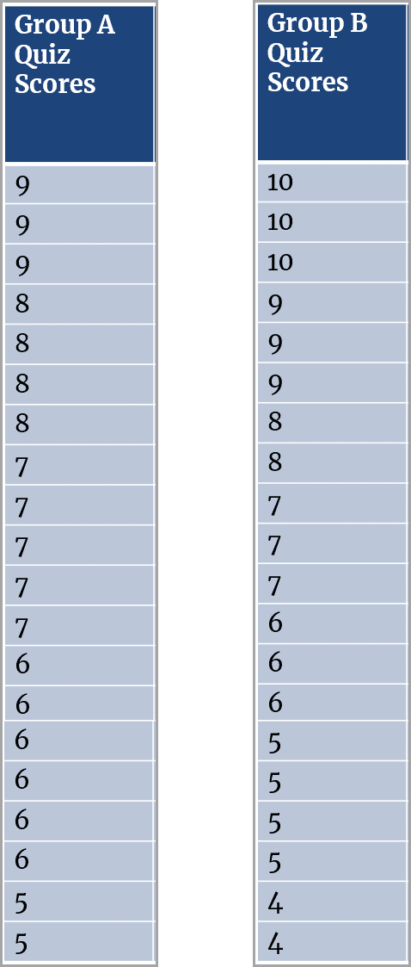
Quiz Scores

Slide 4
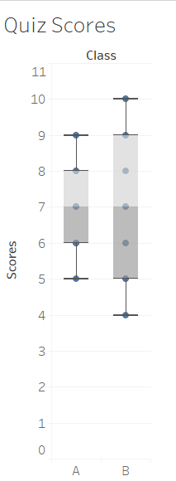
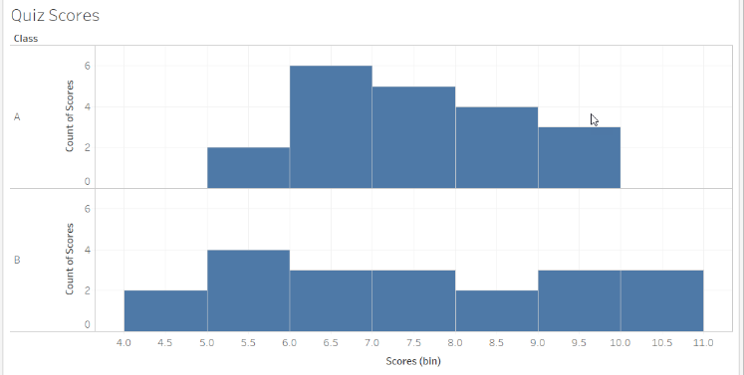
Measures of Variation
Online Stats, page 144-151

Slide 5
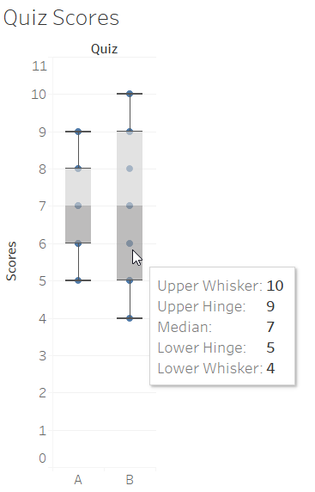
Range and Interquartile Range (IQR)
Range
Quiz A: 4
Quiz B: 6
Interquartile Range (IQR)
Quiz A: 4
Quiz B: 2
Online Stats, pages 144-151

Slide 6
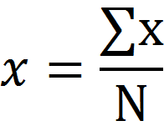
Mean
Mean is arithmetic average
Sum of values/number of values
n
Online Stats, page 144-151

Slide 7
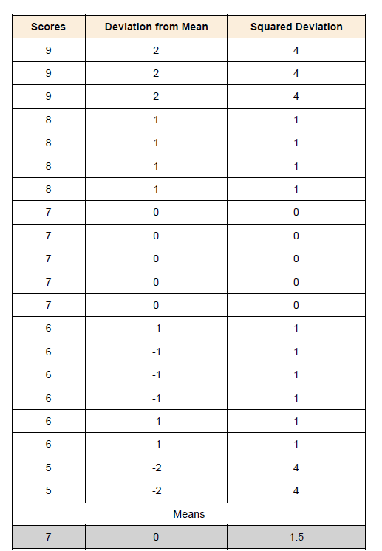
Variance
How far are the scores from the mean?
Online Stats, page 144-151

Slide 8
Variance and Standard Deviation
Quiz A Variance is 1.5 and Quiz B Variance is 6.7
Standard Deviation is Square root of variance
Quiz A standard deviation is 1.22
Quiz B standard deviation is 2.5
Online Stats, page 144-151, Truthful Art, pages 171-172

Slide 9
Normal Curve

Slide 10
Normal Distribution
Online Stats, page 250

Slide 11
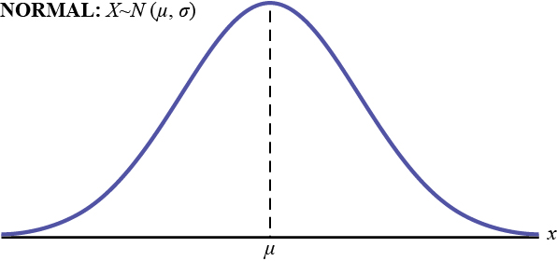
Normal Distribution
Symmetric around the mean.
The mean, median, and mode are equal.
The area under the normal curve is equal to 1.0.
Denser in the center and less dense in the tails.
Defined by two parameters, the mean (μ) and the standard deviation (σ).
Online Stats, page 250 and Truthful Art, pages 188-190

Slide 12
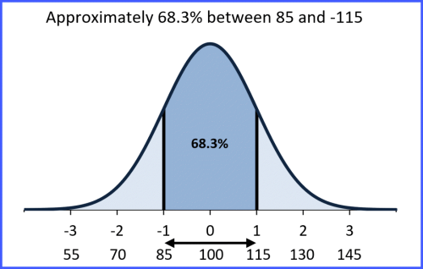
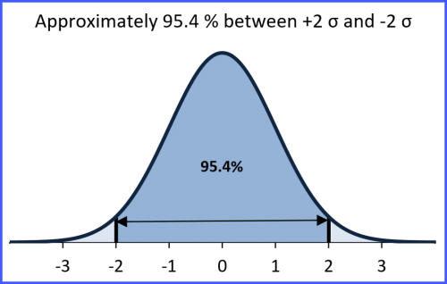
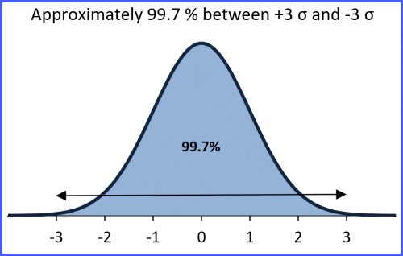
Normal Distribution: The Empirical Rule
Online Stats, page 250 and Truthful Art, pages 188-190

Slide 13
Standard Normal Distribution
Z-score
Actual Score
Online Stats, pages 259-260, Truthful Art, 173-177

Slide 14
Showing Uncertainty

Slide 15
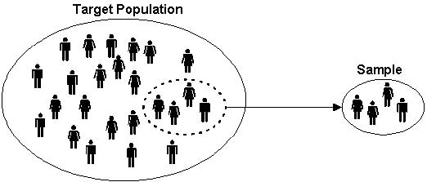
Estimating a Characteristic of a Population from a Sample

Slide 16
Confidence Interval
Tells us the uncertainty around a statistic that you want to report.
Gives us a margin of error.
Will contain the population mean for a specified proportion of the time
Typically 95% or 99% of the time.
Example of 95% interval:
If repeated samples were taken and the 95% confidence interval computed for each sample, 95% of the intervals would contain the population mean.
72.85 < μ < 107.15
Online Stats, page 337 and Truthful Art, pages 308-312

Slide 17
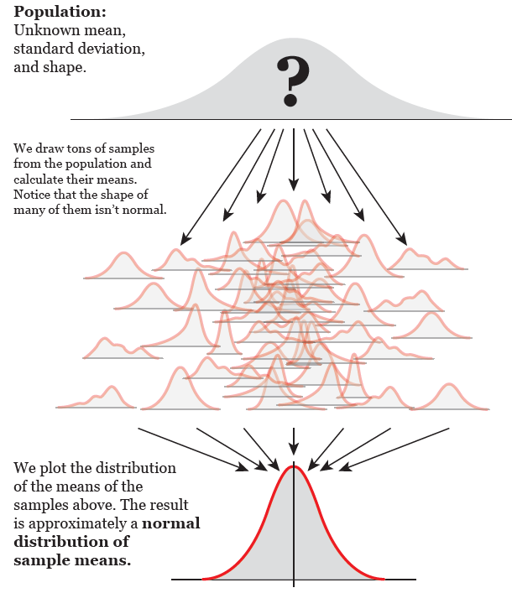
We use the mean and standard deviation to create a margin of error. Why?
Behavior of sample means:
https://youtu.be/fqOOownnkA4
https://youtu.be/cyNqdostWzk
Truthful Art, pages 305-307

Slide 18
Standard Error
Standard Error (s_{m}) is the estimate of the distribution of sample means.
How much will the mean of your specific sample size deviate, on average, from the population mean?
We use the standard deviation and sample size of our sample to estimate the standard error.
Online Stats, pages 343-348 and Truthful Art, pages 305-308

Slide 19
Standard Error Example
Interested in the weights of 10-year-old children.
Take a sample of 9 children
Find a mean of 90 pounds and standard deviation of 36 pounds
SE = 36/3 = 12
Online Stats, page 343

Slide 20
Use Standard Error to Calculate Confidence interval
Interested in the weights of 10-year-old children.
Take a sample of 9 children
Find a mean of 90 pounds and standard deviation of 36 pounds
SE = 36/3 = 12
For 95% interval, use +/- 1.96:
90 - (1.96)(12) = 66.48
90 + (1.96)(12) = 113.52
Confidence Interval: 66.48 to 113.52 pounds
-2
-1
0
1
2
Sampling Distribution of the mean for N=9. The middle 95% is shaded. # of standard errors shown below the weights
Online Stats, page 344

Slide 21
Discussing Uncertainty Activity
https://www.nytimes.com/interactive/2019/08/29/opinion/hurricane-dorian-forecast-map.html

Slide 22
Significance and p-values

Slide 23
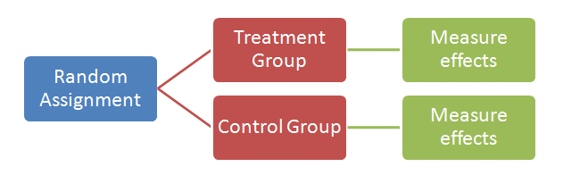
The Controlled Experiment
An experiment with 2 groups (in some cases more):
An Experimental Group (receives some intervention)
A Control Group
If groups are randomly assigned, any difference in the outcome between the Experimental and Control groups should be attributable to the research intervention.

Slide 24

Dependent and Independent Variables
Independent (or explanatory) Variable (what influences the outcome)
The study condition (experimental vs. control group)
Dependent (or response) Variable (what you are trying to change)
What ever it is that you are studying as an outcome

Slide 25
Hypothesis Testing
Null Hypothesis (H₀)
States that there is no relationship between the independent and dependent (outcome) variables.
Alternative Hypothesis (H_{A})
States that there will be a relationship between the independent and dependent variables
The experimental group will differ from controls
H₀ : μ_{treatment} = μ_{control}
H_{A} : μ_{treatment} ≠ μ_{control}

Slide 26
What are p-values?
Use p-values to help decide whether to reject null hypothesis.
“A p-value is the probability, under the assumption that there is no true effect or no true difference, of collecting data that shows a difference equal to or more extreme than what you actually observed.”
“A p-value is not the probability of the effect being real. It is not the probability of the scientist having found a relevant effect.”
Truthful Art, pages 321-325

Slide 27
Power and Effect Size
Power: probability that an experiment will detect an effect of a particular size. The power depends on sample size:
An overpowered (large sample) test may detect effects that are not relevant.
An underpowered (small sample) test may not be able to detect a relevant effect.
Effect Size: the amount of difference a test can detect.
Truthful Art, pages 321-325

Slide 28
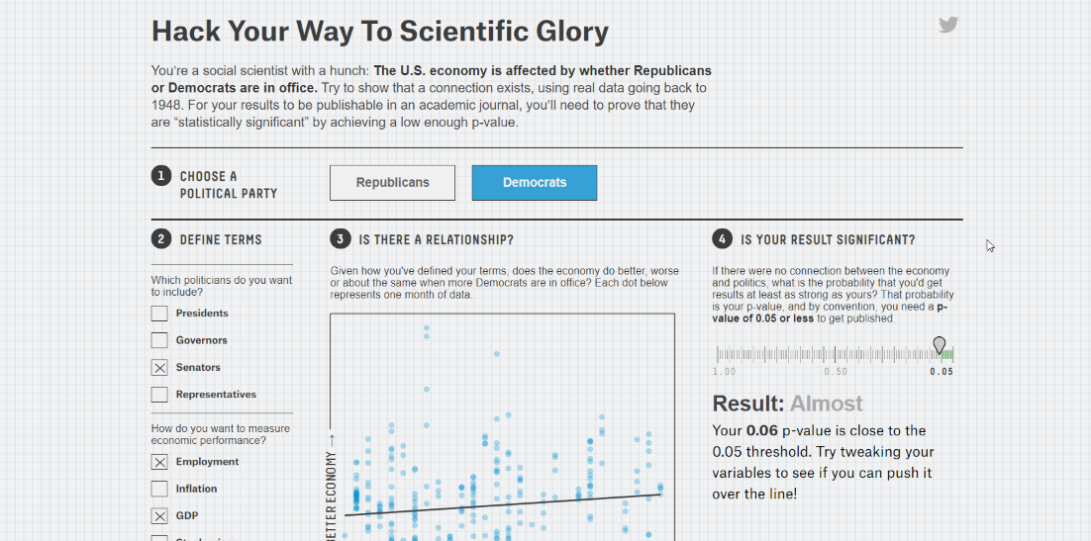
p-hacking activity
https://projects.fivethirtyeight.com/p-hacking/

